Slide 1
Airbnb Destination Analysis
Created on: 10/9/2023
By: Anthony ‘Nero’ Lewis

Slide 2
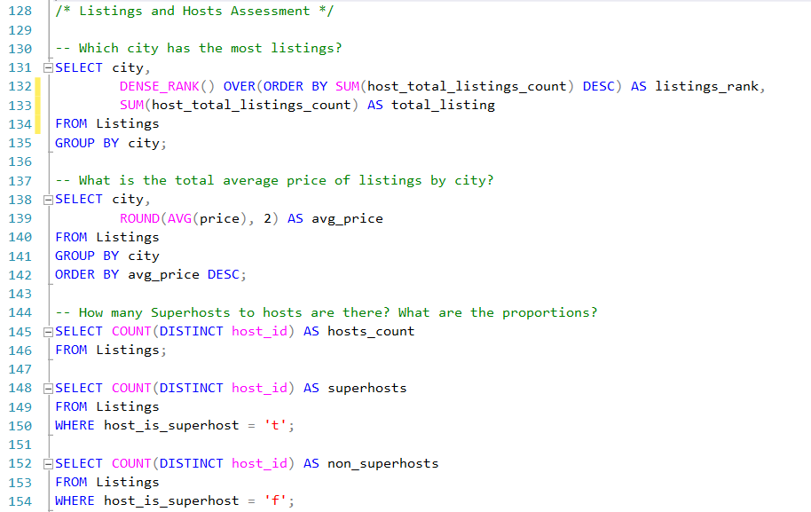


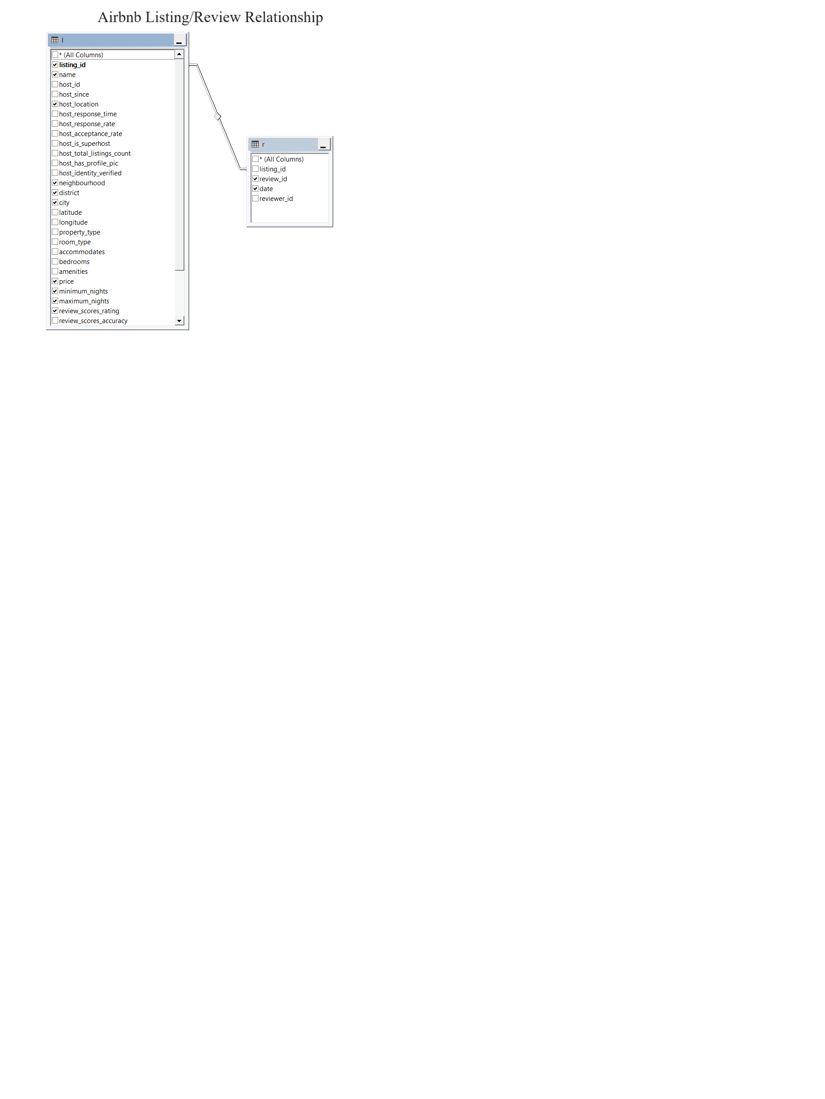
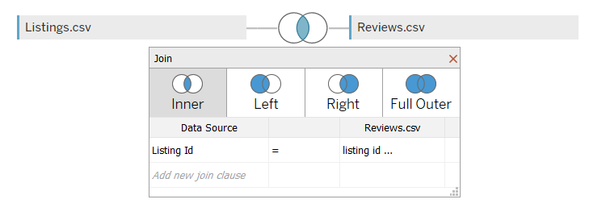

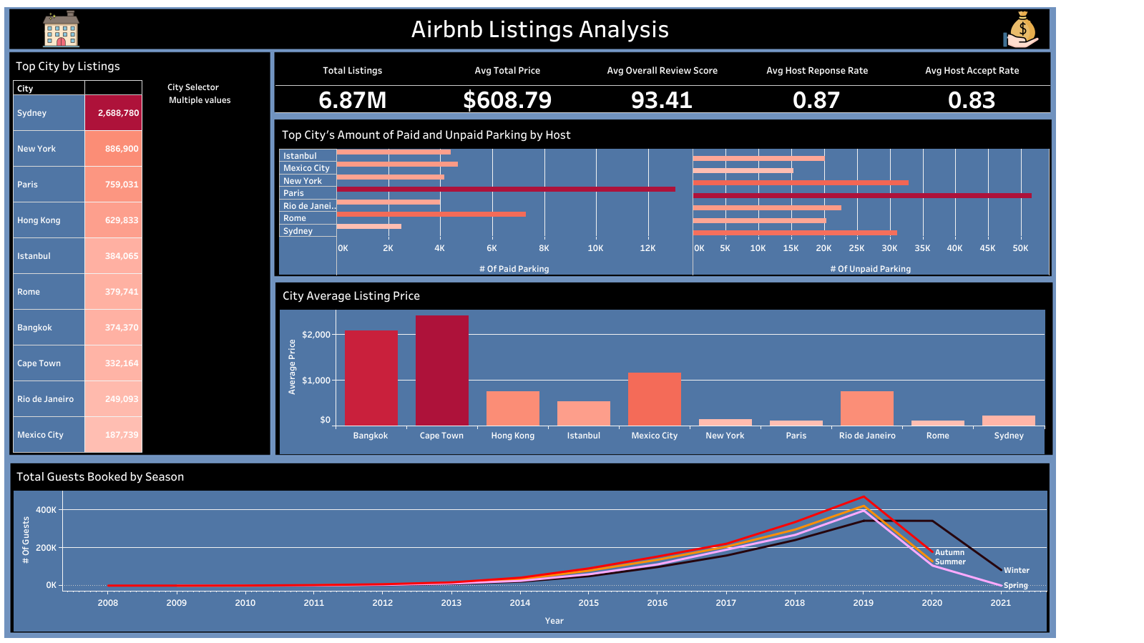


Data Analysis Strategy
Airbnb Listing Data Model
Tableau’s Physical Layer
.CSV
SQL
Queries
SQL to Tableau
ETL
Dashboard
Publish
Tableau Public
Present Findings
Uploaded and saved to Tableau Public website

Slide 3
Data Overview
The goal of this project was to explore the data to answer business questions
The data is on Airbnb and has two datasets:
Listings:
Rows: 279,360
Columns: 33 (name, host_id, host_since, host_location, host_response_time, host_response_rate, host_acceptance_rate, host_is_superhost, host_total_listings_count, host_has_profile_pic, host_identity_verified, neighbourhood, district, city, latitude, longitude, property_type room_type, accommodates, bedrooms, amenities, price, minimum_nights, maximum_nights, review_scores_rating, review_scores_accuracy, review_scores_cleanliness, review_scores_checkin, review_scores_communication, review_scores_location, review_scores_value)
Reviews:
Rows: 5,373,143
Columns: 4 (listing_id, review_id, date, reviewer_id)

Slide 4
Business Task
What city has the most listings?
What are the KPIs (total listings, overall average price, overall review, overall host response rate, overall host accept rate)?
What are the top cities by paid and unpaid parking?
Are there identifiable trends in seasonality in review data?
How many hosts and superhosts are there?
Do superhosts have better response to requests than hosts?
Are there any negative relationships between a review score and another metric?

Slide 5
Data Workflow
Process the data in Excel (explored the listings dataset, cleaned and validated date, explored distribution). Review data was too big for Excel, so it was loaded into Microsoft SQL (MS SQL) Server
Loaded data into MS SQL Server and analyzed the datasets, joining them when necessary
An Entity Relationship called ‘Airbnb Listing Reviews’ was created in MS SQL and queries were used to answer business questions

Slide 6
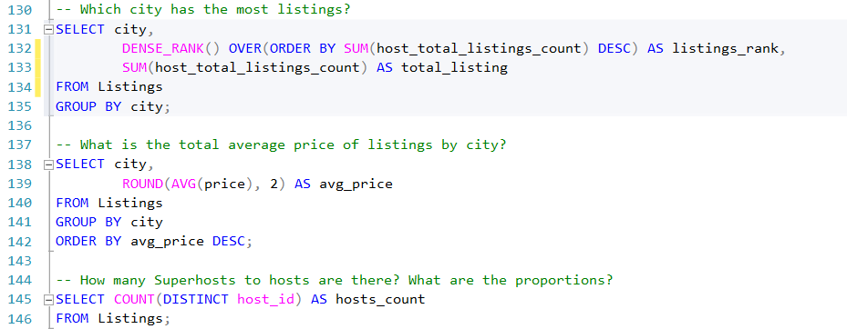
Data Analysis in SQL - Queries

Slide 7
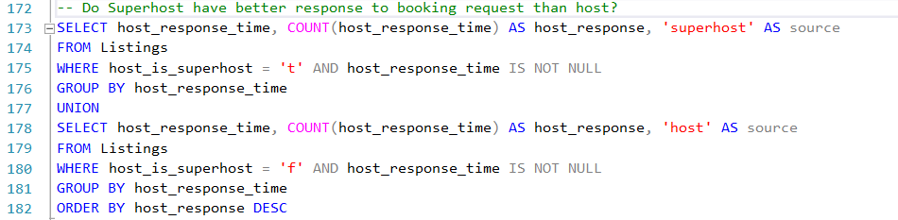
Data Analysis in SQL - Queries

Slide 8
SQL Analysis to Tableau
I loaded the Listings and Review datasets into Tableau, Two data sources were designated:
The listings data
The joined dataset of Listings and Reviews
Joining was done on the physical layer
The data source page was used to process the data into accurate data types
I created several calculated fields and sets to transform and create visualizations
Some calculated fields such as Average, Count, Sum, If/Else were used to answer the business questions as follows

Slide 9
First Dashboard

Slide 10
First Overall Findings
The total Airbnb listings were over 6 million, with an average booking price of approximately $608.00, the average overall review totaled around 94.00, and average host response time and accept rate ranged from high to low 0.80
The top city with the most listings is Sydney, totaling over 2 million, and Paris has the most paid and unpaid parking with New York and Sydney following
When looking at the total bookings from 2008 to 2021, year 2019 had the highest booked guests with Autumn being the peak season while Winter became the peak season in 2020

Slide 11
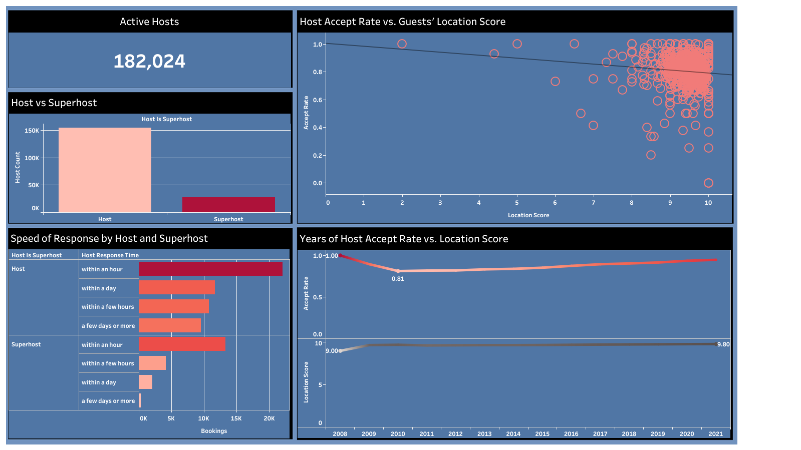
Second Dashboard

Slide 12
Second Overall Findings
There were 182,024 hosts, with 154,621 being hosts, and 27,280 being superhosts
Though hosts have more bookings, possibly due to a larger count of them, superhosts booked over 13,000 compared to their count of 27,280 while hosts booked 22,000 compared to their over 150,000 count
The only statistically significant negative correlation was the host accept rate vs. the location review score, p-value = 0.006; for as the accept rate increases. a slight decrease occurs in location review score, though this relationship is very weak

Slide 13
Thank you for viewing
Feedback is welcome

Slide 14
References
Data source: Maven Analytics
Most images source: https://www.flaticon.com/icons
Presentation image source: <a href="https://www.freepik.com/free-vector/managers-meeting-business-mentorship-workers-conference-company-strategy-discussion-mentor-teaching-employees_12085856.htm#query=presenting&position=20&from_view=search&track=sph">Image by vectorjuice</a> on Freepik

